Slide 1

Case Study 01
Francisco Breia de Oliveira , N2503383A

Slide 2
Site Map
Home
Menu
Music
Jobs

Slide 3
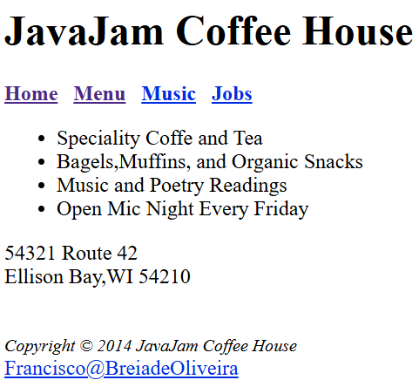
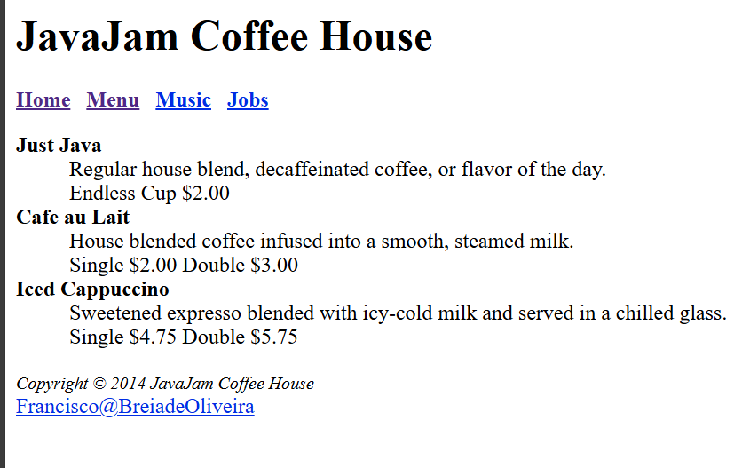
Storyboard
1º scenario, view the Menu
Click on “Menu” at the navigation bar to view the list of coffee and drink options

Slide 4
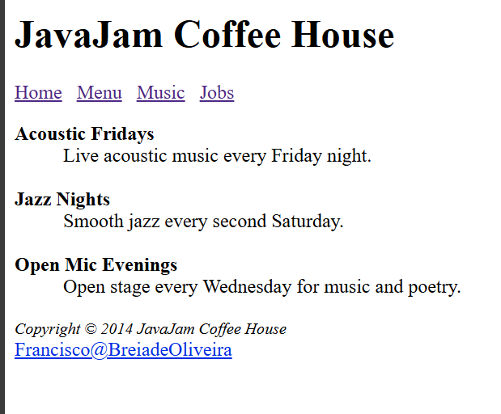
Storyboard
2º scenario, View the type of Music
Click on “Music” in the navigation bar to view the music options

Slide 5
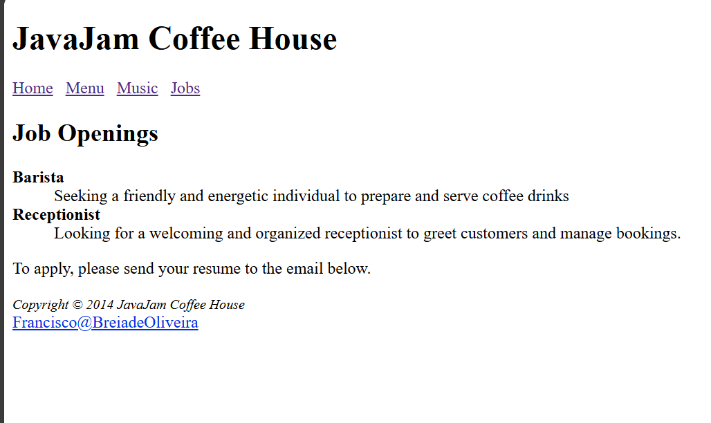
Storyboard
3º scenario, searching for job opportunities
Click on “Job” at the navigation bar to see new job opportunities

Slide 6
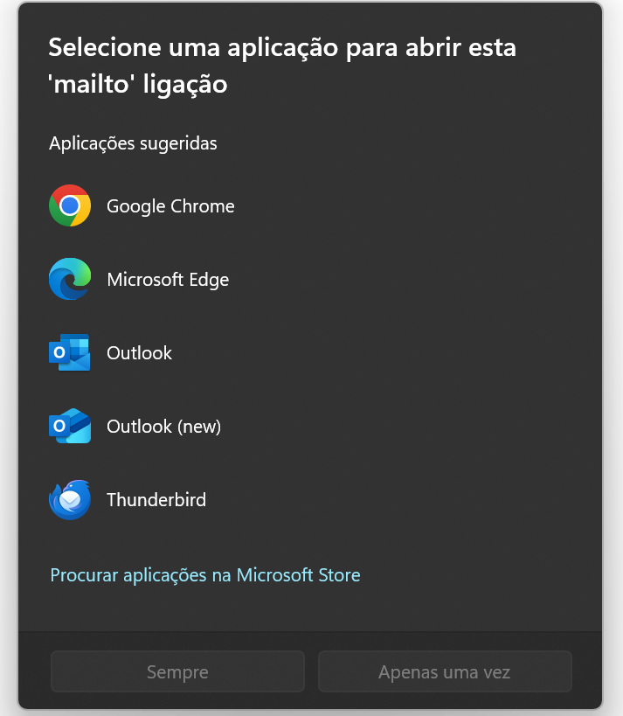
Storyboard
4º scenario, sending an email
Clicking the email link will open your email program so you can send a message to the coffee house owner.

Slide 7

Wireframe
JavaJam Coffee House
header
Home
Menu
Music
Jobs
navigation
Item 1
Item 2
Item 3
Item 4
index.html
content
Address
footer

Slide 8
Wireframe
JavaJam Coffee House
header
Home
Menu
Music
Jobs
navigation
Drink 1
Description
menu.html
Drink 2
Description
content
Drink 3
Description
footer

Slide 9
Wireframe
JavaJam Coffee House
header
Home
Menu
Music
Jobs
navigation
Night theme 1
Description
music.html
Night theme 2
content
Description
Night theme 3
Description
footer

Slide 10
Wireframe
JavaJam Coffee House
header
Home
Menu
Music
Jobs
navigation
Job Openings
Job 1
jobs.html
Description
content
Job 2
Description
footer

